Slide 1
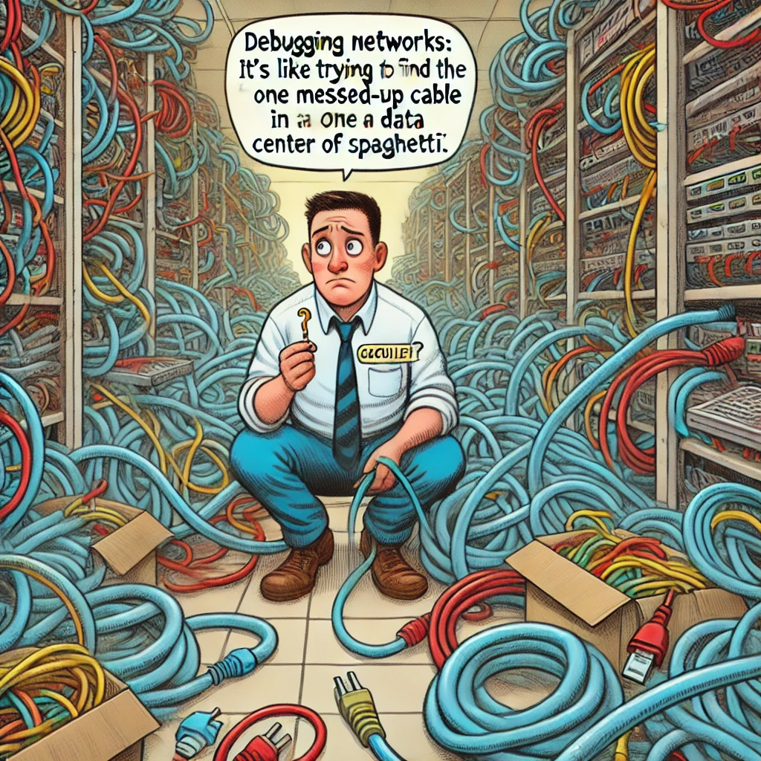
Decoding the Language of Networks
WHOAMI
Hi, I’m a Engineer, your guide through the chaos of protocols and services.

Slide 2
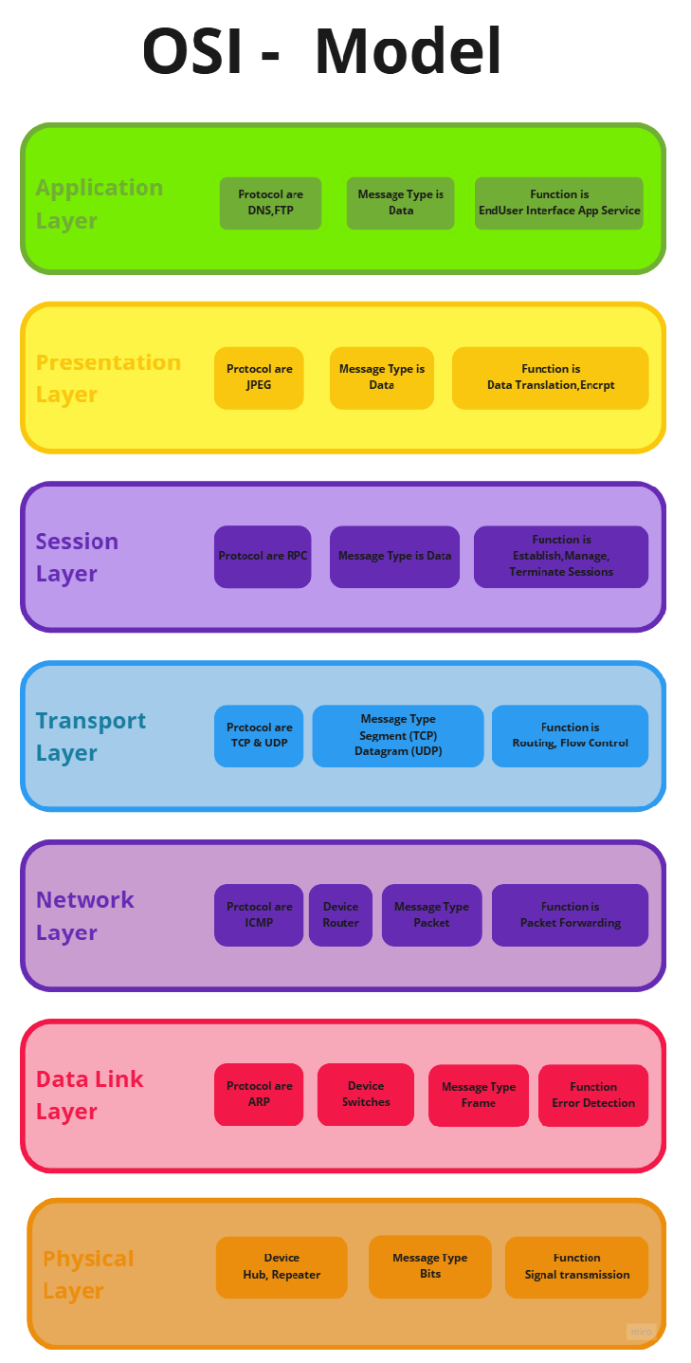
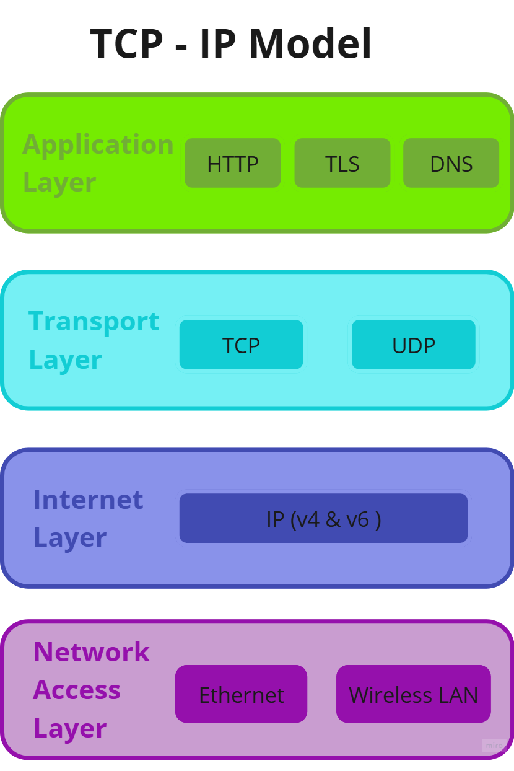
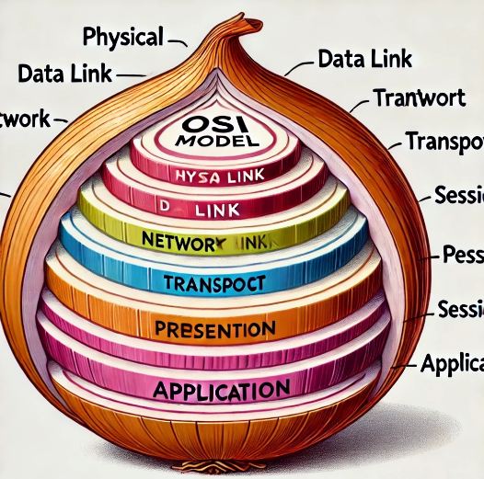
OSI Model – The Backbone of Networking
Internaltional Standard Organization (ISO)
An organization that sets international Standards for various measurements.
What is the OSI Model?
The Open System InterConnection (OSI) is a framework dividing networking into 7 layers.
Standardizes communication and simplifies troubleshooting.
TCP/IP Protocol
TCP/IP stands for Transmission Control Protocol/Internet Protocol, and it is used for communication protocols. It combines TCP and IP protocols
Nowadays QUIC protocol is used which is a combination of TCP , UDP , HTTP.

Slide 3
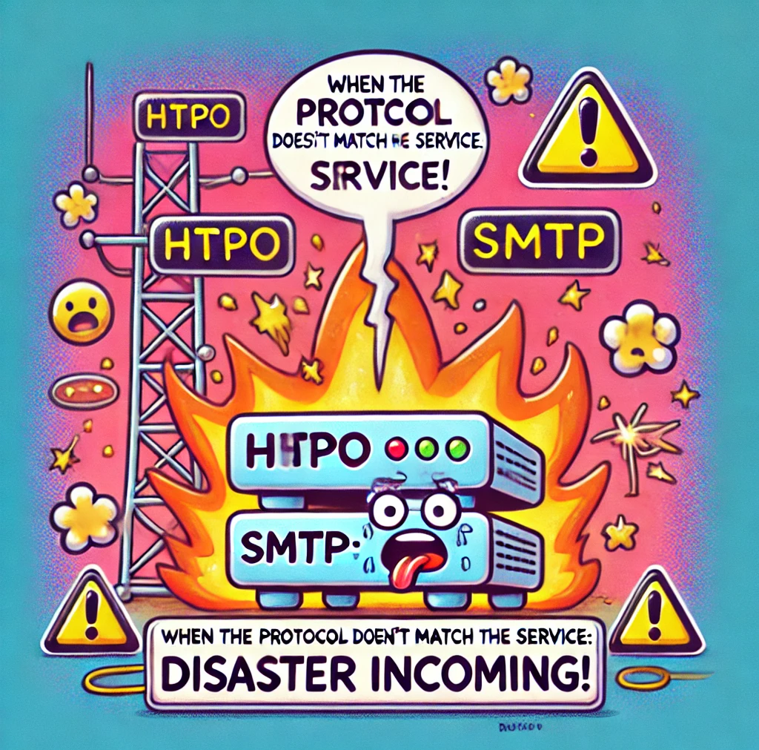
What Are Network Protocols and Services?
Protocols: Rules for communication between devices.
Services: Functionalities provided (e.g., file sharing, web browsing).
Analogy: Railways (Services) and Ticketing Rules (Protocols).
Network Protocol is like Rules and Regulation for communication between Endpoints (Computer and devise) on network.
When multiply Endpoint (Machine) are connected in a NETWORK there needs to be RULES in places to determine which Endpoint can provide SERVICES And which ones can access those SERVICE.
Think of NETWORK SERVICE as the functionalities or feature that a NETWORK can offer. To make using these service easier and organized.
Rules and Protocols are created similar how RAILWAY provide service to the public but the rules of ticketing to use those SERVICE.

Slide 4
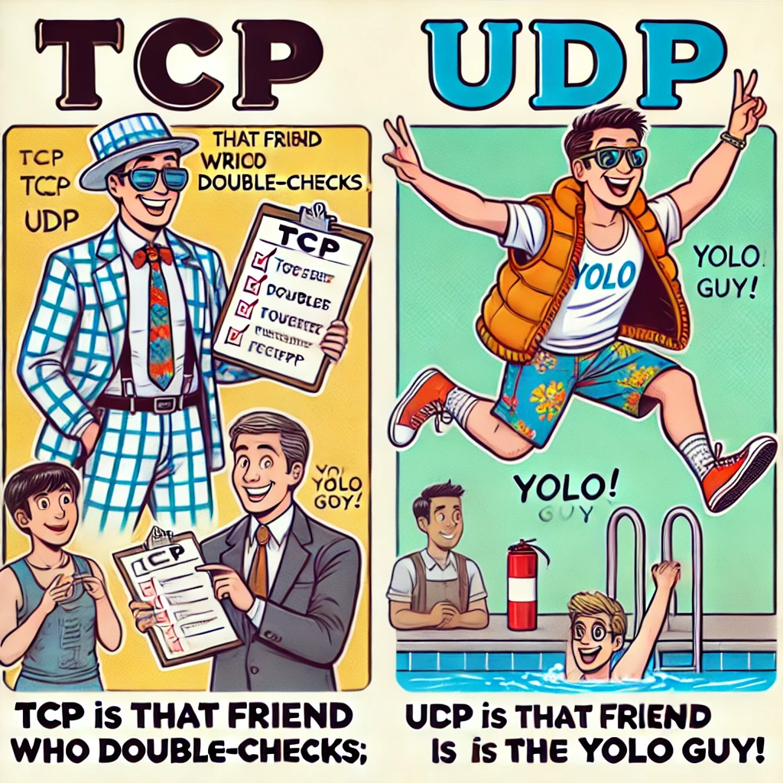
TCP vs. UDP
TCP: Reliable, connection-oriented (Three-Way Handshake).
Use cases: Email, web browsing.
UDP: Fast, connectionless, no delivery guarantee.
Use cases: Streaming, gaming.

Slide 5
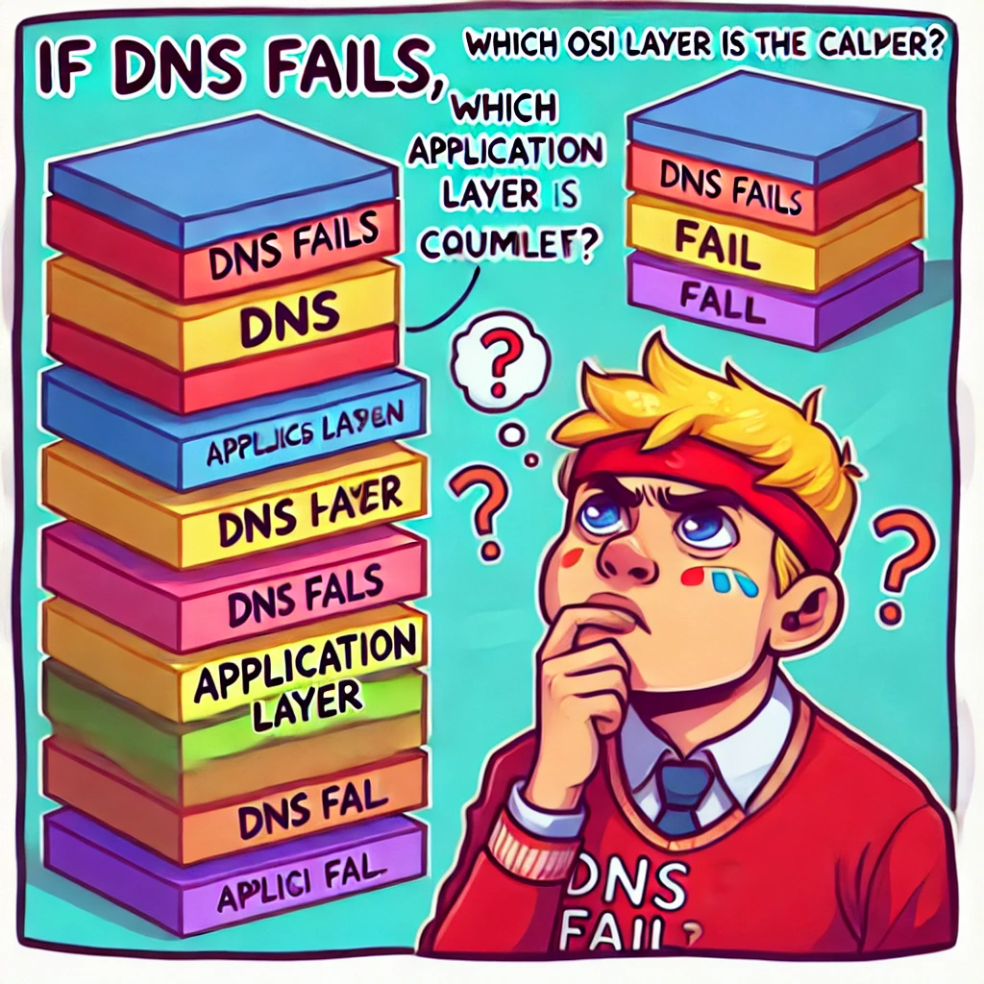
Mapping Protocols to OSI Layers
Diagnosing HTTP issues:
Application Layer: Is the server running?
Transport Layer: Are TCP ports open?
Network Layer: Can the client reach the server?
Activity: “If DNS fails, which OSI layer is the culprit?”

Slide 6
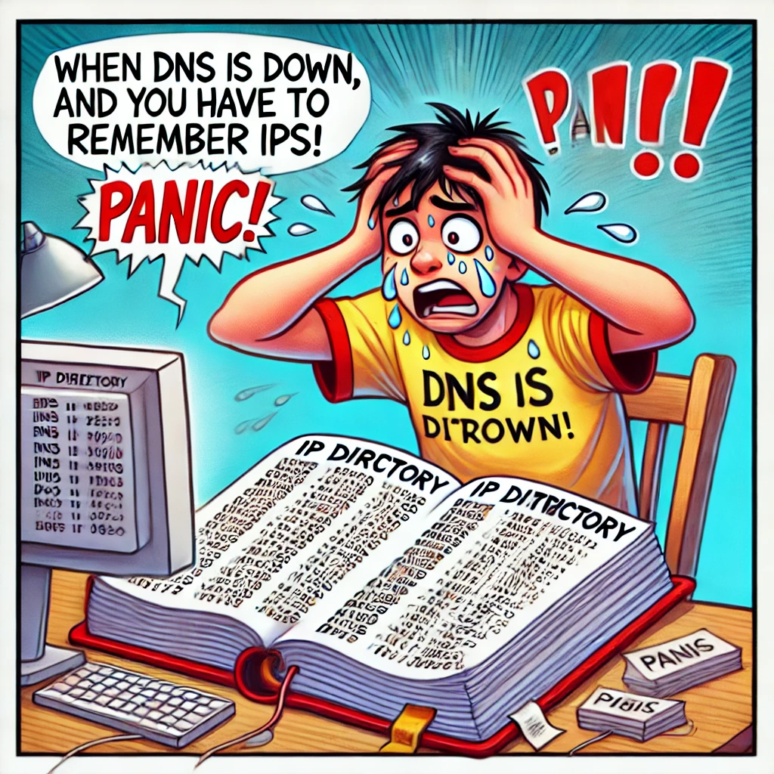
Key Application Protocols
HTTP/HTTPS:
HTTP: Insecure, port 80.
HTTPS: Secure with SSL/TLS, port 443.
DNS:
Resolves domain names to IPs.
UDP/TCP on port 53.

Slide 7
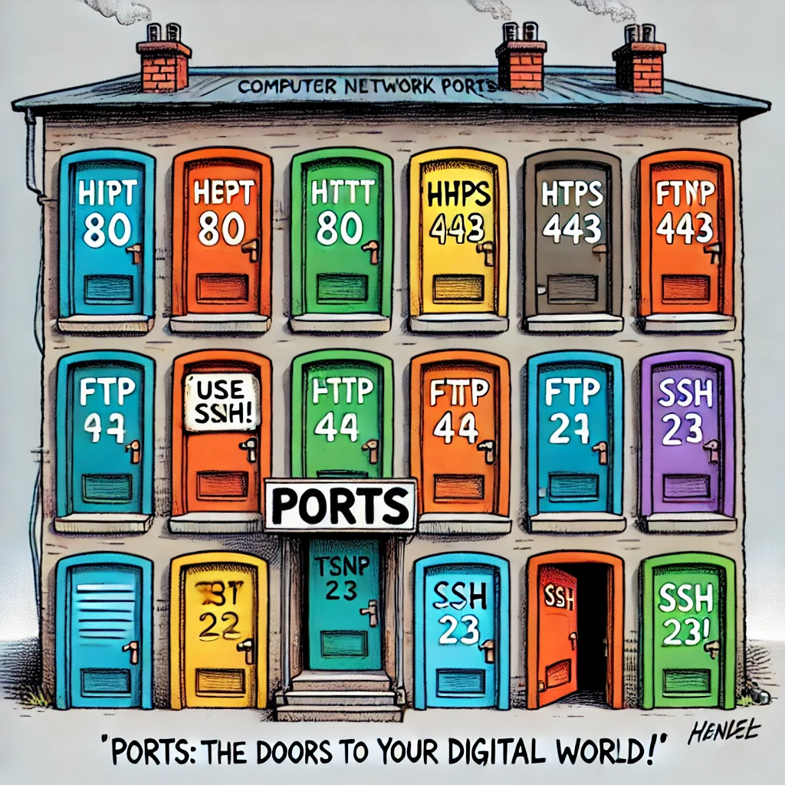
Ports – The Digital Gateways
Types:
Physical Ports: Ethernet, USB.
Virtual Ports: Logical connections, 0–65535.
Comparison: TCP (reliable) vs. UDP (fast but risky).
Additional Info:
Port number 0 is used when there's no specific port assigned. In such cases, the operating system or application dynamically assigns an available port. This is particularly useful when connecting with multiple tabs in a browser or handling multiple simultaneous communications.

Slide 8
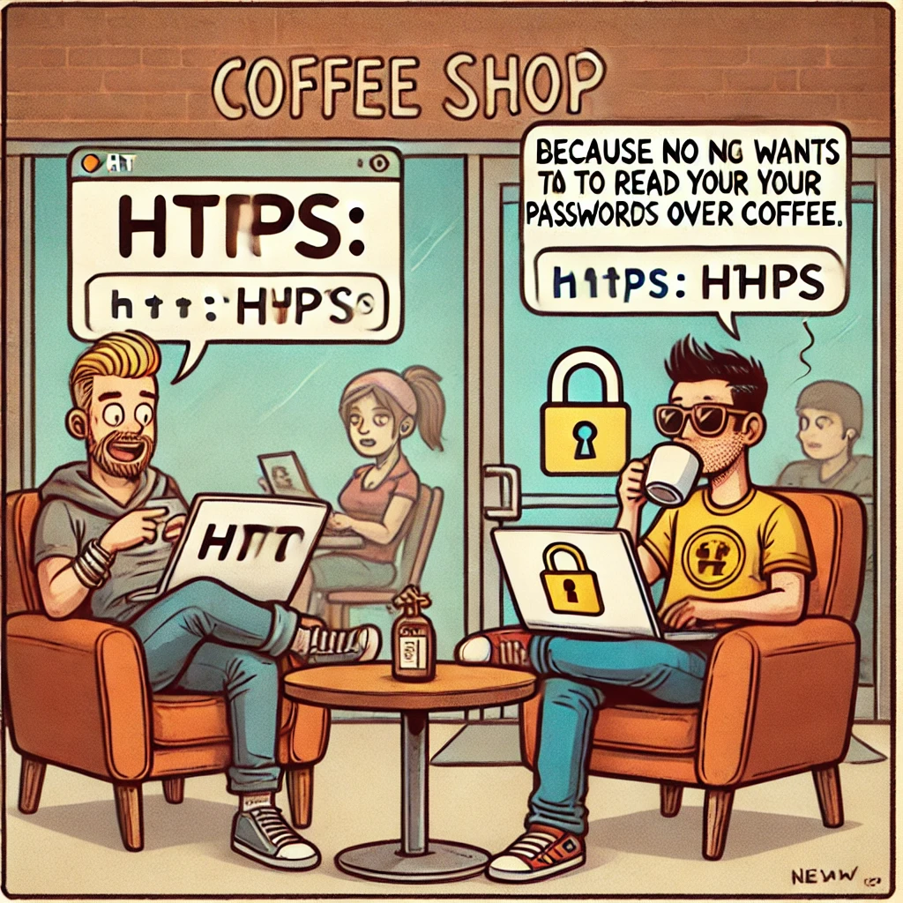
Security Services
HTTPS: Encrypts communication using SSL/TLS.
SFTP: Secure file transfers via SSH. And More..

